Slide 1


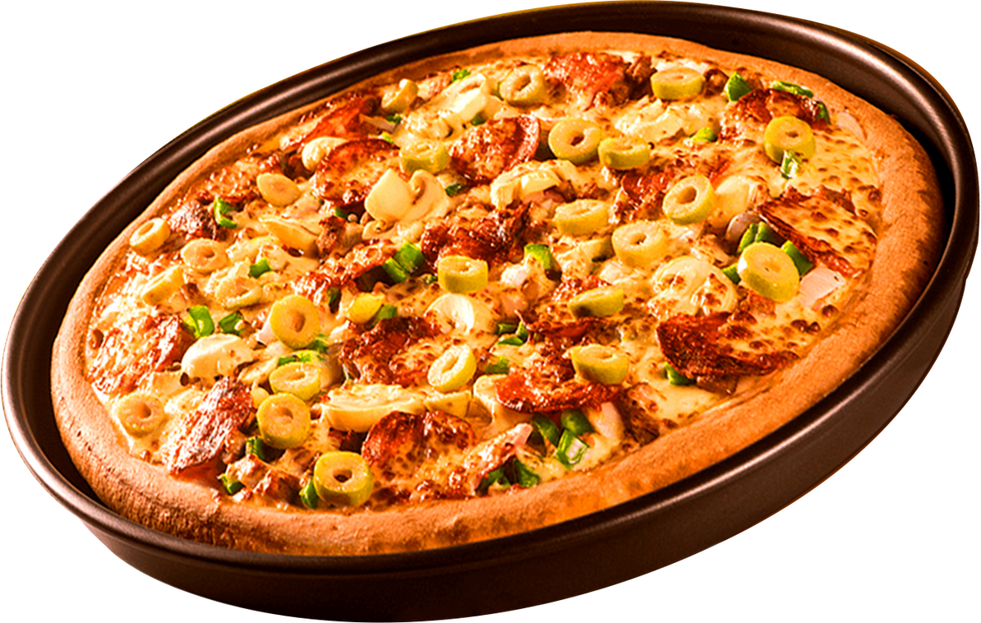


PIZZA SALES ANALYSIS
SQL project
by Himanshu Bhatt

Slide 2
PIZZA SALES ANALYSIS
BASIC:
Retrieve the total number of orders placed.
Calculate the total revenue generated from pizza sales.
Identify the highest-priced pizza.
Identify the most common pizza size ordered.
List the top 5 most-ordered pizza types along with their quantities.
INTERMEDIATE:
Join the necessary tables to find the total quantity of each pizza category ordered.
Determine the distribution of orders by hour of the day.
Join relevant tables to find the category-wise distribution of pizzas.
Group the orders by date and calculate the average number of pizzas ordered per day.
Determine the top 3 most-ordered pizza types based on revenue.
ADVANCED:
Calculate the percentage contribution of each pizza type to total revenue.
Analyze the cumulative revenue generated over time.
Determine the top 3 most ordered pizza types based on revenue for each pizza category.
Home
About

Slide 3

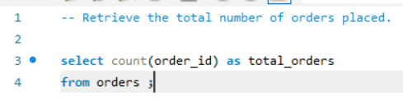

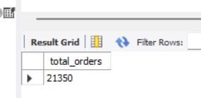
BASIC
PIZZA SALES ANALYSIS
Q1. Retrieve the total number of orders placed.
Home
About

Slide 4
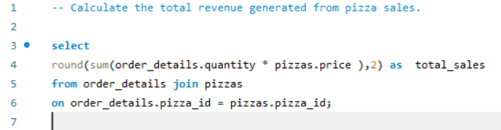
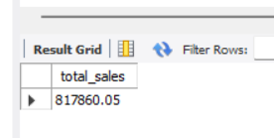
BASIC
PIZZA SALES ANALYSIS
Home
Q2. Calculate the total revenue generated from pizza sales.

Slide 5
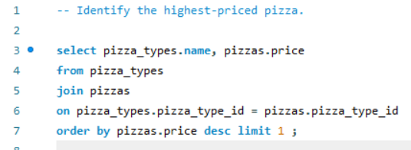
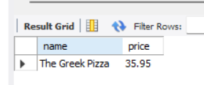
BASIC
PIZZA SALES ANALYSIS
Q3. IDENTIFY THE HIGHEST-PRICED PIZZA.

Slide 6
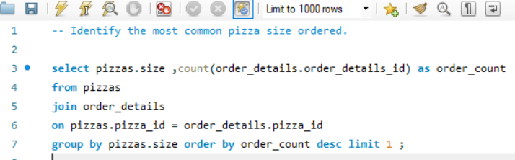

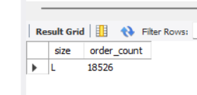
BASIC
PIZZA SALES ANALYSIS
Q4. IDENTIFY THE MOST COMMON PIZZA SIZE ORDERED.

Slide 7
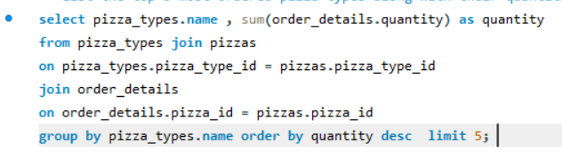
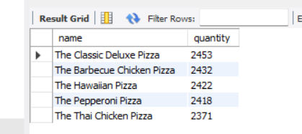
BASIC
PIZZA SALES ANALYSIS
Q5. List the top 5 most-ordered pizza types along with their quantities.

Slide 8
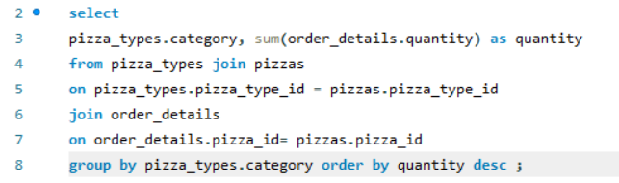
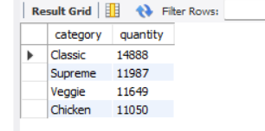
INTERMEDIATE
PIZZA SALES ANALYSIS
Q1. Join the necessary tables to find the total quantity of each pizza
category ordered.

Slide 9
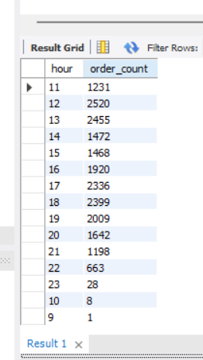
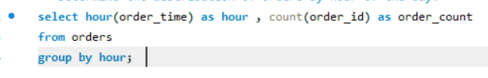
INTERMEDIATE
PIZZA SALES ANALYSIS
Q2. Determine the distribution of orders by hour of the day.

Slide 10
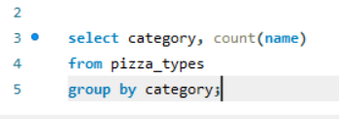
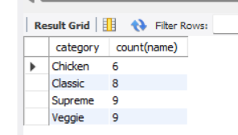
INTERMEDIATE
PIZZA SALES ANALYSIS
Q3. Join relevant tables to find the category-wise distribution of pizzas.

Slide 11
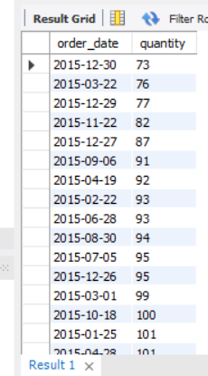
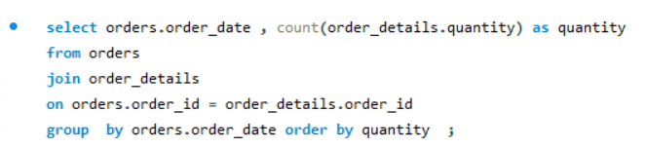
INTERMEDIATE
PIZZA SALES ANALYSIS
Q10. Group the orders by date and calculate the average number of pizzas ordered
per day.

Slide 12
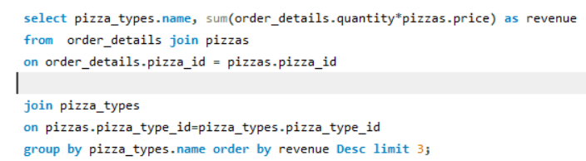
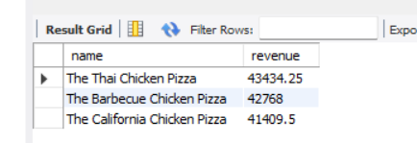
INTERMEDIATE
PIZZA SALES ANALYSIS
Q5. Determine the top 3 most ordered pizza types based on revenue.

Slide 13
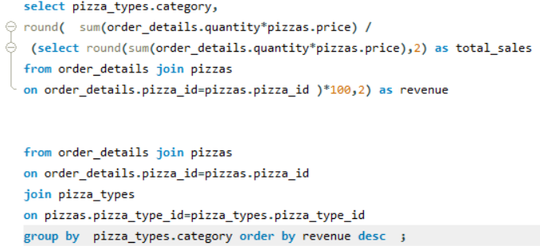
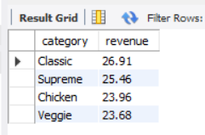
ADVANCED
PIZZA SALES ANALYSIS
Q1. Calculate the percentage contribution of each pizza type to total revenue.

Slide 14
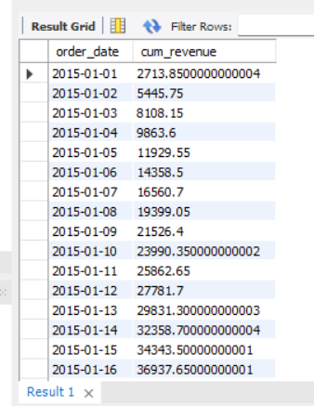
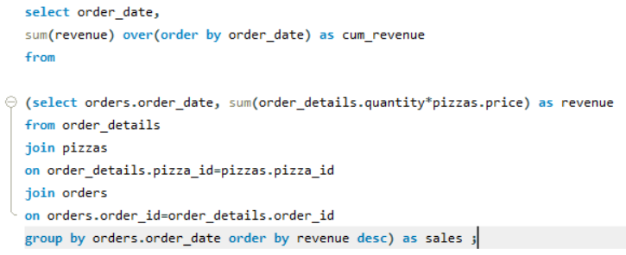
ADVANCED
PIZZA SALES ANALYSIS
About
Contact
Q13. Analyze the cumulative revenue generated over time.

Slide 15
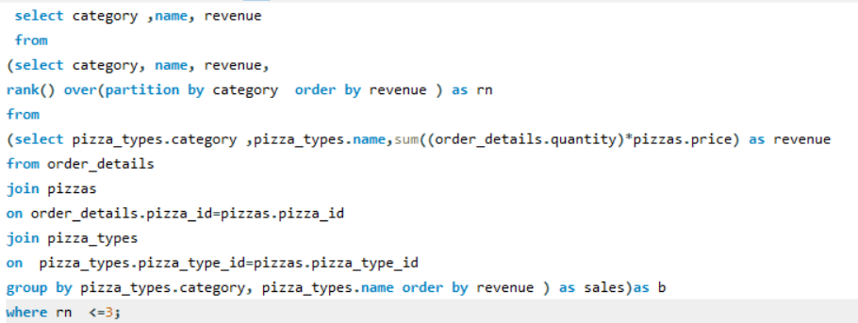
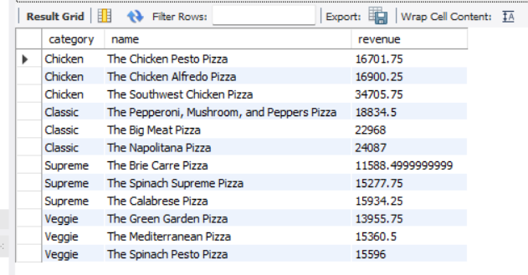
pizza sales analysis
pizza sales analysis
ADVANCED
PIZZA SALES ANALYSIS
Q14. Determine the top 3 most ordered pizza types based on revenue for each
pizza category.

Slide 16
PIZZA SALES ANALYSIS
THANK YOU
FOR ATTENTION
by Himanshu Bhatt

